Slide 1
Adjustment of irrigation to mitigate climate change impacts in Cyprus
Panagiotis Dalias, Anastasis Christou and Damianos Neocleous
Agricultural Research Institute
Natural Resources and Environment
Presentation: Panagiotis Dalias
Climatico 2019

Slide 2
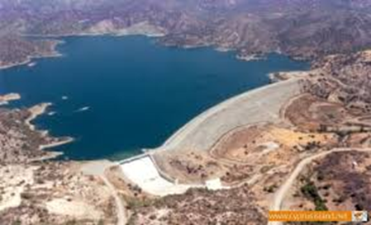
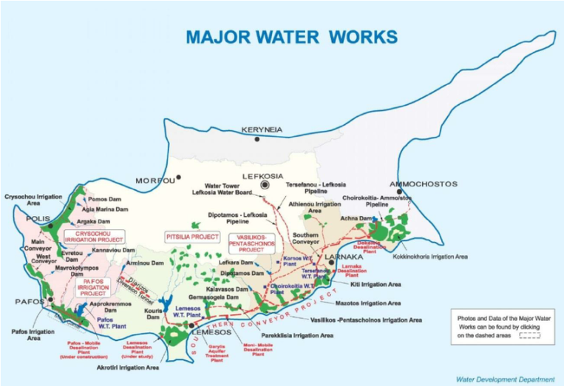
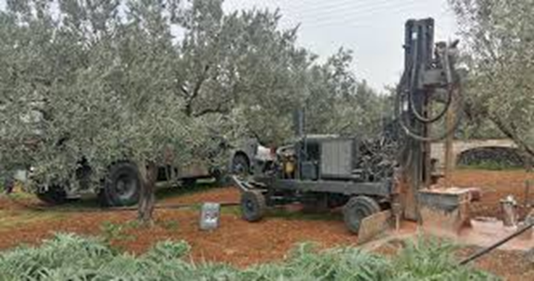
Effects of climate change on irrigation water (1)
Water availability in dams
Availability of underground water

Slide 3
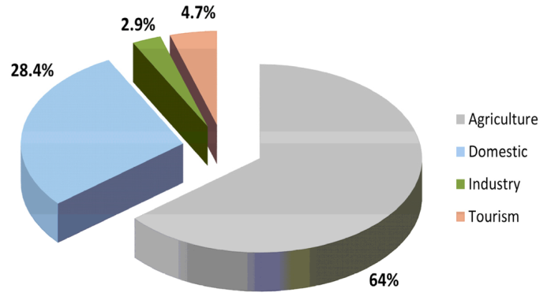
Effects of climate change on irrigation water (2)
Impact on irrigation scheduling (total amount of water supplied to crops and allocation to months)
Impact on the total amount of irrigation water that is used for crops
Sofroniou and Bishop, 2014
Dependent on data availability and data analysis

Slide 4
What we wanted to do
Following current practices of irrigation planners (e.g. Water Development Department of Cyprus)
Re-estimate irrigation water demands of crops (which depend on average meteorological conditions )
Identify eventual changes due to climate change (at least to some of them)
Recalculate irrigation scheduling (determination of the correct frequency and duration of watering)
(recalculate the total irrigation water that is needed depending on the acreage of each crop)

Slide 5
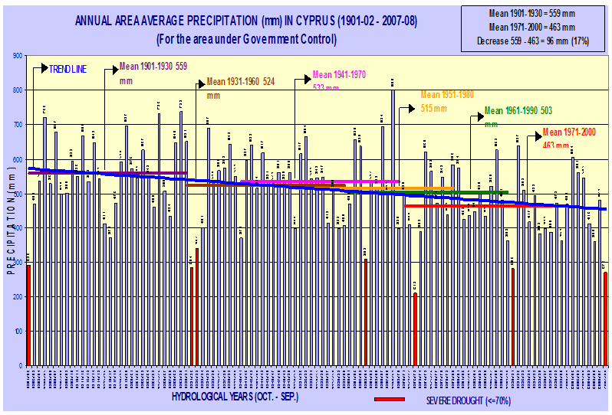
Meteorological evidence pointing to changes in irrigation water needs
1) Mean annual rainfall decreases
Stelios Pashiardis - Department of Meteorology

Slide 6
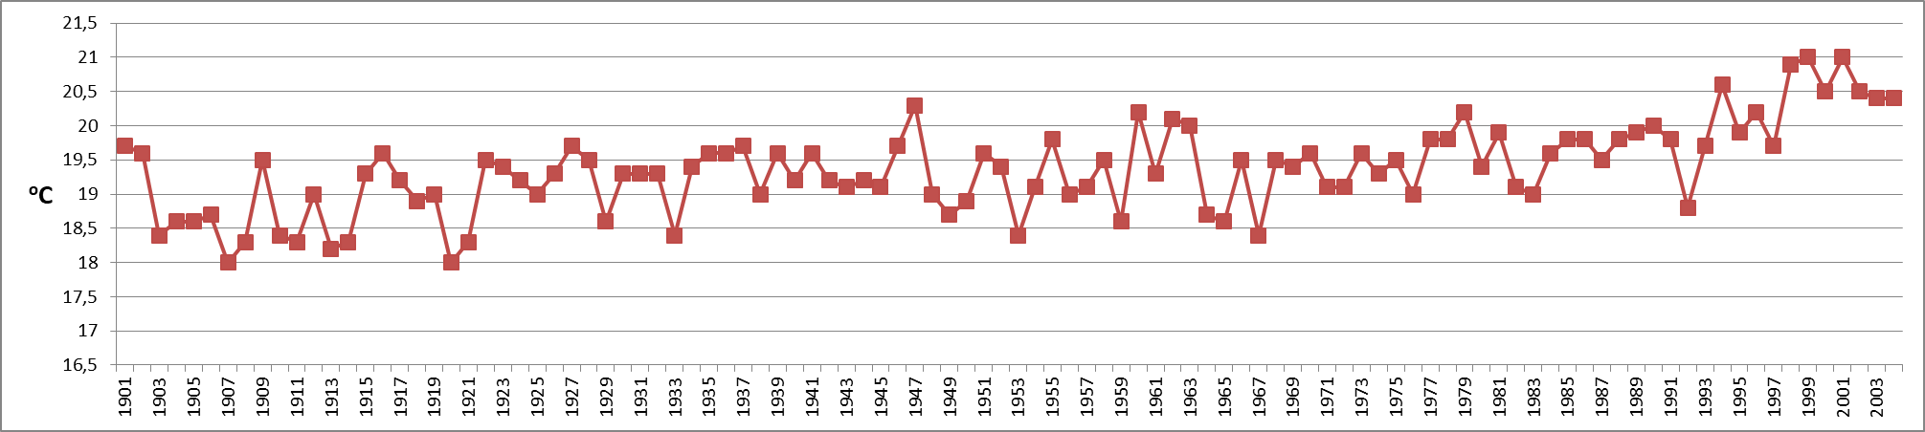
2) Mean annual temperature increases
Mean annual temperature in Cyprus
Data source: Department of Meteorology

Slide 7
Significant indications for increases in Evapotranspiration
Stelios Pashiardis - Department of Meteorology

Slide 8
Effect of climate variability and climate change on crop production and water resources in Cyprus
Adriana Bruggeman, Christos Zoumides, Stelios Pashiardis, Panos Hadjinicolaou, Manfred A. Lange and Theodoros Zachariadis

Slide 9
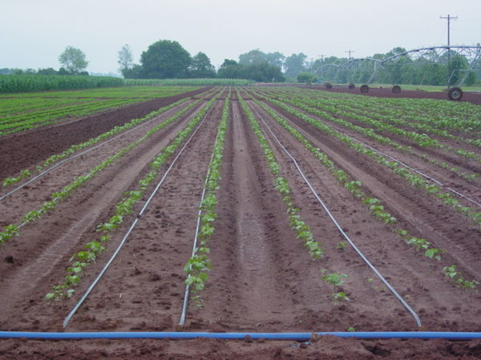
Net Irrigation Requirements
=
-
Crop Evapotranspiration
Effective Rainfall
NIR = ET_{crop} – P_{e}

Slide 10
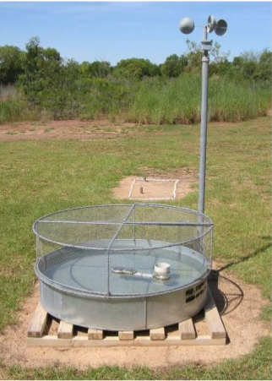
To estimate ETcrop (ETc)…
ΕT_{o} = K_{p} x E_{pan}
ET_{crop} = K_{c} x ET_{o}
ET_{crop} = C x E_{pan}
ETcrop: Crop evapotranspiration (mm)
ETο: Reference evapotranspiration (mm)
Epan: Pan evaporation
Kc: crop coefficient
Kp: Pan coefficient
C = Kc x Kp (ARI experimental results)
Class A pan evaporimeter

Slide 11
Water and irrigation needs of Citrus and Potatoes
They were calculated using evaporation and precipitation data of the last 38 years (provided by the Meteorological Department of Cyprus), and which they were plotted against time to reveal eventual increasing or decreasing trends. The 4 weather stations that were chosen for each crop are situated close to the main areas of their cultivation.
Citrus and potatoes consume one-third of the total irrigation water in Cyprus (23.4% and 10%, respectively) (Markou and Papadavid 2007)

Slide 12
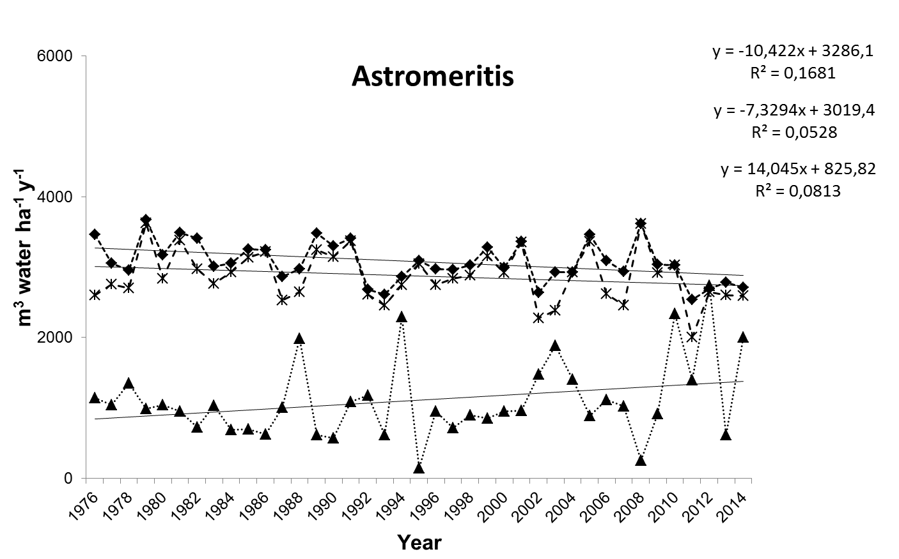
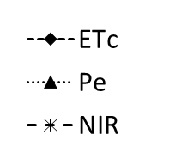

Slide 13
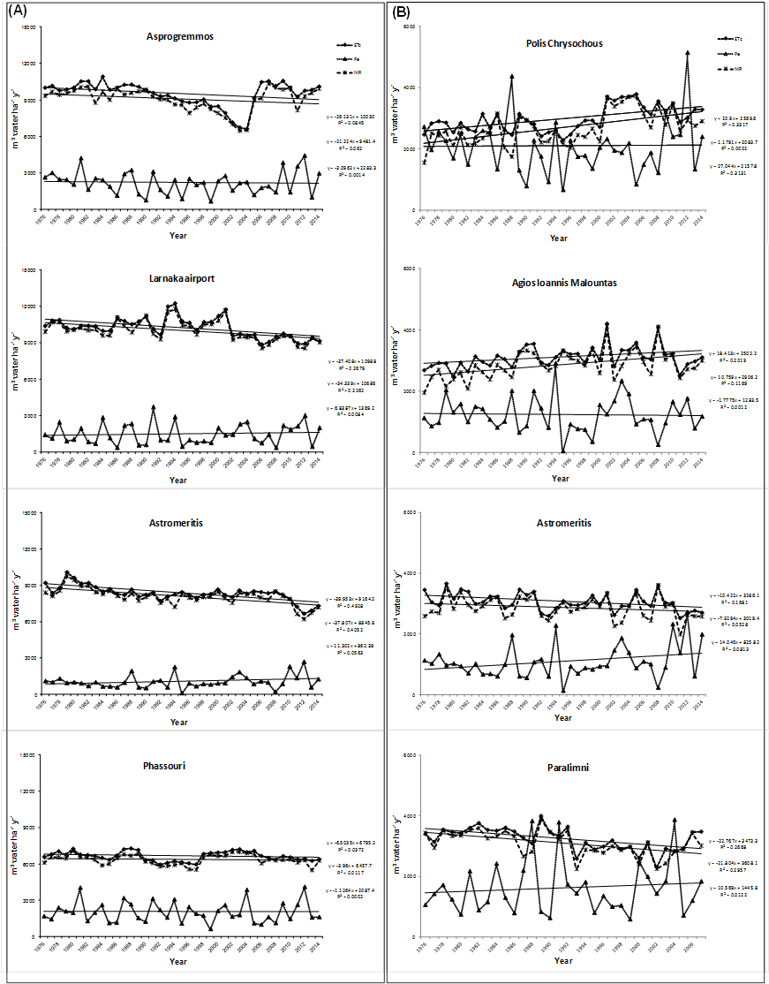
Citrus
Asprogremmos
Airport of Larnaca
Astromeritis
Fassouri
Spring potatoes
Polis Chrysochous
Agios Ioannis Malountas
Astromeritis
Paralimni

Slide 14
In some cases there were no statistically significant trends of increase or reduction of the three variables, in others there were significantly different from zero ... but there were not always in the same direction at the different stations. Results showed almost all combinations of change:
No change of precipitation and increase in water and irrigation needs
No change of rainfall and reduction of water and irrigation needs
Increase in rainfall and reduction of water and irrigation needs
Reduction of rainfall and reduction of water and irrigation needs

Slide 15
Combining data of evaporation (Epan) and rainfall from 16 meteorological stations of Cyprus we recalculated irrigation needs of crops for the periods 1976-2000 and 1990-2014.

Slide 16
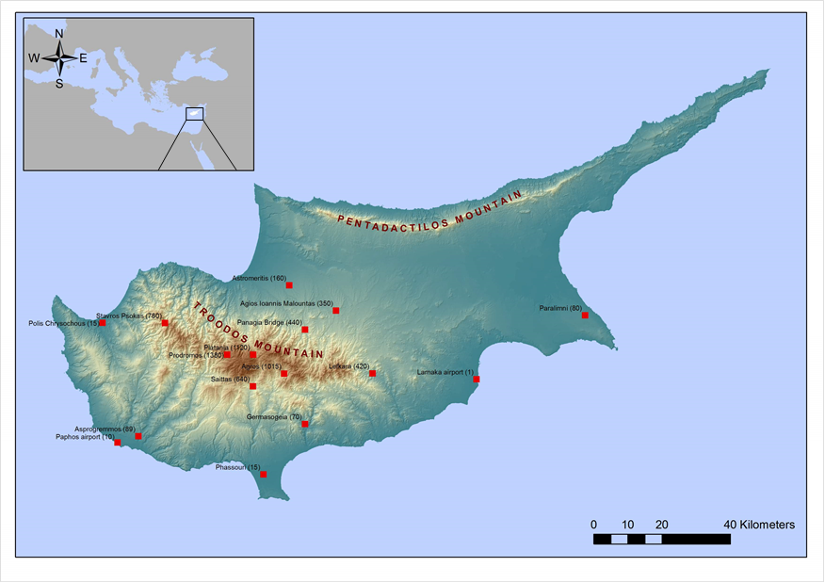
Spatial distribution of the 16 weather stations providing meteorological data during the period 1976-2014

Slide 17
Crops |  | Period evaluated |  |  | Total ETc (m³ ha⁻¹ year⁻¹) |  | Paired t-test (P value)
Tree crops
Almonds |  | 1 |  |  | 3518 |  | 0,103
 |  | 2 |  |  | 3445
Bananas |  | 1 |  |  | 12437 |  | 0,141
 |  | 2 |  |  | 12184
Citrus & Avocado |  | 1 |  |  | 8392 |  | 0,165
 |  | 2 |  |  | 8237
Fruit trees (Lowlands / plains) |  | 1 |  |  | 8127 |  | 0,129
 |  | 2 |  |  | 7973
Fruit trees (Mountains) |  | 1 |  |  | 6771 |  | 0,128
 |  | 2 |  |  | 6641
Pistachio |  | 1 |  |  | 3518 |  | 0,099
 |  | 2 |  |  | 3443
Table grapes |  | 1 |  |  | 3044 |  | 0,529
 |  | 2 |  |  | 3023
Table olives |  | 1 |  |  | 4270 |  | 0,132
 |  | 2 |  |  | 4186
Walnut (Pecan) |  | 1 |  |  | 9885 |  | 0,119
 |  | 2 |  |  | 9676
Vegetables
Artichokes |  | 1 |  |  | 4455 |  | 0,329
 |  | 2 |  |  | 4390
Cabbage |  | 1 |  |  | 3060 |  | 0,074
 |  | 2 |  |  | 2972
Carrots |  | 1 |  |  | 4180 |  | 0,999
 |  | 2 |  |  | 4180
Celery |  | 1 |  |  | 4308 |  | 0,219
 |  | 2 |  |  | 4216
Cucumber (greenhouse) |  | 1 |  |  | 5756 |  | 0,597
 |  | 2 |  |  | 5713
Cucumber |  | 1 |  |  | 4718 |  | 0,197
 |  | 2 |  |  | 4649
Eggplants |  | 1 |  |  | 5890 |  | 0,109
 |  | 2 |  |  | 5766
Effective rainfall |  | 1 |  |  | 2543 |  | 0,482
 |  | 2 |  |  | 2540
1: period 1976-2000; 2: period 1990-2014

Slide 18
Crops |  | Period evaluated |  |  | Total ETc (m³ ha⁻¹ year⁻¹) |  | Paired t-test (P value)
Vegetables
Eggplants |  | 1 |  |  | 5890 |  | 0,109
 |  | 2 |  |  | 5766
Green beans (greenhouse) |  | 1 |  |  | 4442 |  | 0,675
 |  | 2 |  |  | 4414
Green beans |  | 1 |  |  | 6057 |  | 0,351
 |  | 2 |  |  | 5992
Lettuce |  | 1 |  |  | 3349 |  | 0,233
 |  | 2 |  |  | 3265
Marrows |  | 1 |  |  | 5054 |  | 0,185
 |  | 2 |  |  | 4976
Melons |  | 1 |  |  | 5153 |  | 0,176
 |  | 2 |  |  | 5069
Okra |  | 1 |  |  | 6727 |  | 0,183
 |  | 2 |  |  | 6616
Onions (dried) |  | 1 |  |  | 3583 |  | 0,772
 |  | 2 |  |  | 3571
Peas |  | 1 |  |  | 1934 |  | 0,742
 |  | 2 |  |  | 1926
Pepper |  | 1 |  |  | 5511 |  | 0,119
 |  | 2 |  |  | 5399
Potatoes (spring) |  | 1 |  |  | 2989 |  | 0,898
 |  | 2 |  |  | 2994
Potatoes (mid season) |  | 1 |  |  | 1400 |  | 0,568
 |  | 2 |  |  | 1360
Potatoes (late season) |  | 1 |  |  | 4870 |  | 0,439
 |  | 2 |  |  | 4760
Radish |  | 1 |  |  | 4149 |  | 0,181
 |  | 2 |  |  | 4051
Spinach |  | 1 |  |  | 3653 |  | 0,088
 |  | 2 |  |  | 3535
Effective rainfall |  | 1 |  |  | 2543 |  | 0,482
 |  | 2 |  |  | 2540
1: period 1976-2000; 2: period 1990-2014

Slide 19
Crops |  | Period evaluated |  |  | Total ETc (m³ ha⁻¹ year⁻¹) |  | Paired t-test (P value)
Vegetables
Taro (Kolokasi) |  | 1 |  |  | 23836 |  | 0,143
 |  | 2 |  |  | 23355
Tomatoes (greenhouse) |  | 1 |  |  | 7395 |  | 0,588
 |  | 2 |  |  | 7342
Tomatoes |  | 1 |  |  | 6485 |  | 0,136
 |  | 2 |  |  | 6363
Watermelons |  | 1 |  |  | 5054 |  | 0,185
 |  | 2 |  |  | 4976
Arable crops
Haricot beans |  | 1 |  |  | 4490 |  | 0,254
 |  | 2 |  |  | 4440
Peanuts (Monkey nuts) |  | 1 |  |  | 5253 |  | 0,142
 |  | 2 |  |  | 5153
Effective rainfall |  | 1 |  |  | 2543 |  | 0,482
 |  | 2 |  |  | 2540
1: period 1976-2000; 2: period 1990-2014
Water and irrigation needs calculated for each crop separately did not differ significantly between the two periods 1976-2000 and 1990-2014

Slide 20
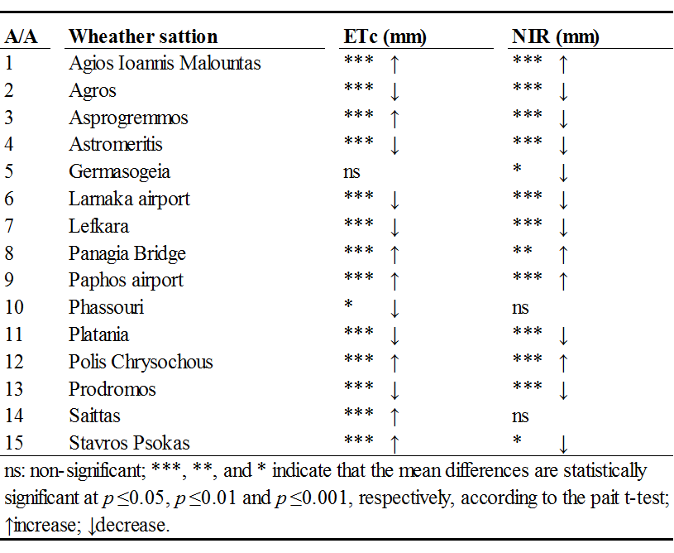
On the contrary, water and irrigation needs calculated for each station separately differed significantly between the two periods
Changes were not everywhere at the same direction

Slide 21
Conclusions – comments
No differences were found in the water and irrigation needs of crops between the two study periods.
The reconsideration of the total irrigation water needed in Cyprus seems not justified (for the time being)
The great diversification of water and irrigation needs between areas indicate the importance of calculating these needs based not on average meteorological data of a region or a country but on the specific data of the area of interest (if available).
Living in a changing climate someone does not face everywhere the conditions of the mean

Slide 22
Seasonal changes
P-values for the comparison of crop evapotranspiration (ETc) between the two periods
ETc
 | winter | spring | summer | autumn
Almonds |  |  | 0,2010 | 0,0680
Artichokes |  | 0,5017 | 0,1985 | 0,0947
Bananas |  | 0,9467 | 0,1873 | 0,0865
Broad Beans |  | 0,7803 | 0,2418
Cabbage: General |  |  | 0,1630 | 0,0868
Carrots | 0,6292 | 0,7001 |  | 0,2586
Celery |  | 0,0051 |  | 0,0959
Citrus and Avocado |  | 0,9130 | 0,1958 | 0,0759
Colocass |  | 0,8604 | 0,1901 | 0,0936
Cucumber: greenhouse | 0,1199 | 0,8507 |  | 0,2098
Cucumber: outside grown |  | 0,6747 | 0,1911
Eggplant low tunnels | 0,0847 | 0,7370 | 0,2548
Eggplant outside grown (aubergine) |  | 0,6543 | 0,1773 | 0,0695
Fruit trees (lowlands/plain) |  | 0,7166 | 0,1943 | 0,0680

Slide 23
Seasonal changes
P-values for the comparison of Net Irrigation Requirements (NIR) between the two periods
NIR
 | winter | spring | summer | autumn
Fruit trees (mountains) |  | 0,7157 | 0,1989 | 0,0680
Green Beans: greenhouse | 0,1132 | 0,6404 |  | 0,1973
Haricot Beans |  |  |  | 0,0728
Lettuce | 0,6292 |  |  | 0,1639
Marrows: outside grown |  | 0,6714 | 0,1924
Melons: outside grown |  | 0,6714 | 0,1879
Monkey Nuts |  | 0,6080 | 0,1667 | 0,0680
Okra (Lady´s fingers) |  | 0,9315 | 0,1750
Onions Dried |  | 0,9814 | 0,5567
Peas General |  | 0,8110
Peppers: outside grown |  | 0,6533 | 0,1773 | 0,0680
Pistachio |  |  | 0,1903 | 0,0680
Potatoes (spring crop) |  | 0,8070
Radish |  | 0,0054 |  | 0,0959
Spinach |  |  |  | 0,0959
Table grapes |  | 0,6484 | 0,5567
Table Olives |  | 0,6271 | 0,1953 | 0,0712

Slide 24
Monthly changes - ETc
Non-significant differences n.s. (paired t-test) ,*: significant differences (P < 0.05), n/a: non-applicable.

Slide 25
Monthly changes - NIR
Non-significant differences n.s. (paired t-test) ,*: significant differences (P < 0.05), n/a: non-applicable.

Slide 26
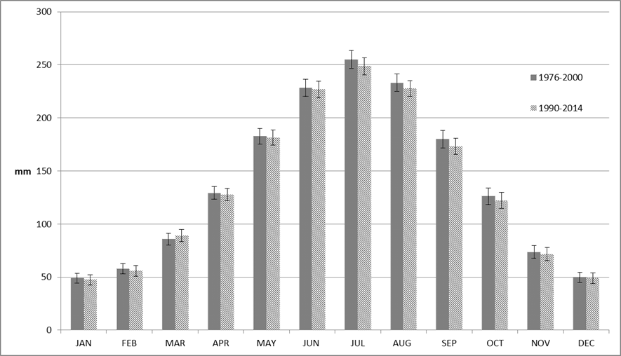
*
*
Monthly averages for Class A Pan Evaporation (mm) over the two 24-year periods (1976-2000 and 1990-2014).

Slide 27
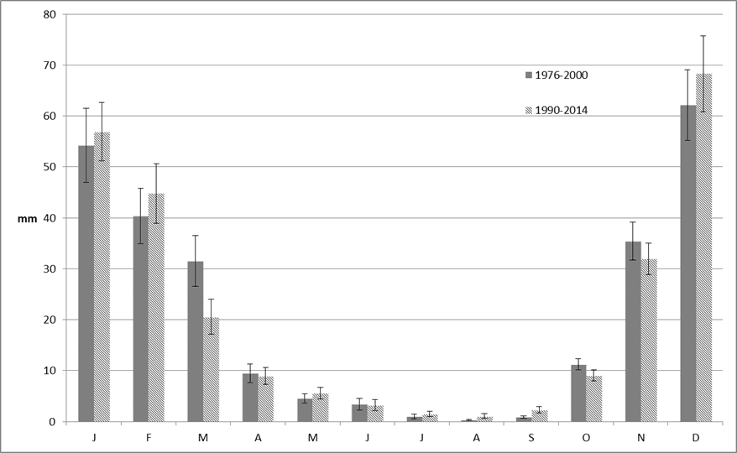
*
*
*
*
*
*
*
Monthly averages for effective rainfall over the two 24-year periods (1976-2000 and 1990-2014).

Slide 28
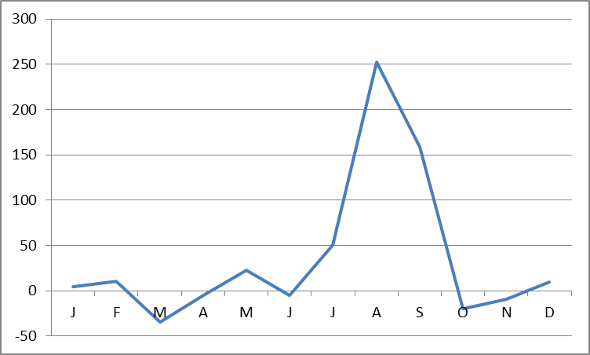
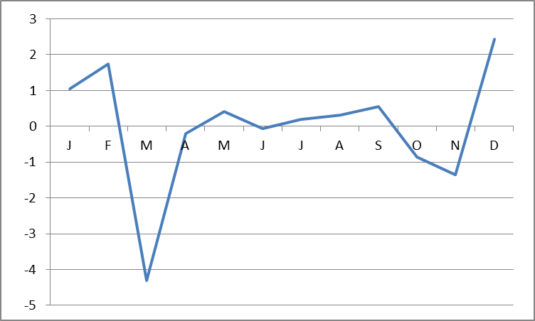
% change of rainfall for each month
% change in relation to overall rainfall (of the whole year)

Slide 29
Deficit irrigation water supply may affect critical growth stages of crops with disproportionately greater negative impact on yields and quality

Slide 30
Conclusions – comments
The adjustment of irrigation schedules to climate change should not rely on annual trends.
Scrutinizing the month by month changes revealed strong trends of evapotranspiration increase during March, which in combination with a respective decrease in precipitation indicates that an adjustment of irrigation water provision to crops is needed. Irrigation programs that are based on long-term evaporation data would result in water deficiencies this month, which may affect critical growth stages of plants. The negative effect on yields could be pronounced and disproportional to what would be expected by the magnitude of mismatch between overall water demands and water provision.

Slide 31
Conclusions – comments
Irrigation should be applied as an adaptation measure to safeguard yields if meteorological trends continue as they are today.
An earlier shift of plantation dates could alternatively be envisaged also as an adaptation measure (e.g. spring potato cultivations), as crops would have completed their life cycles before the less favourable conditions of March.

Slide 32
Thank you!

