Slide 1
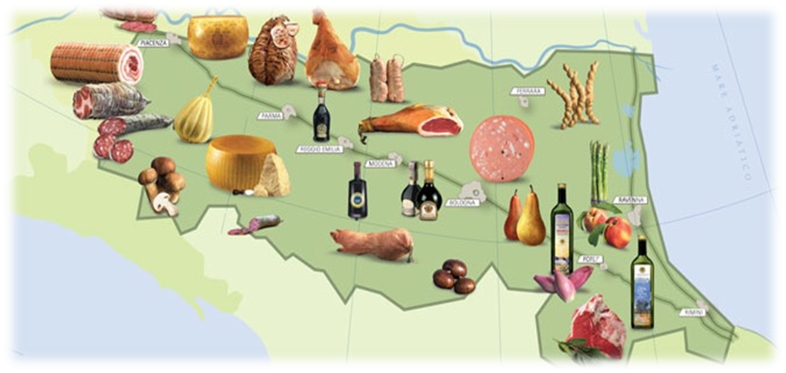
FOOD Excellences: PDO and GPI product
Emilia-Romagna is the most representative region in Italy for number and value of quality and geographical indications products (PDO and IGP):
43 PDO and IGP out of 290 in Italy.
> 40% of the turnover of Italian PDO and PGI products
1
Direzione Generale Agricoltura, Caccia e Pesca

Slide 2
FOOD Excellences: PDO and GPI products
PDO – How Safety and Quality are pursued :
- Rules, standards and disciplinary of production for farmers,
processing and seasoning firms.
- Controls of standards and quality of food, including traceability with a «filieres approach».
Emilia-Romagna The Best four regional POD-PGI | Turnover (mio euro) | Relevance %
Parmigiano-Reggiano cheese -PDO | 1,276 | 19%
Parma Ham -PDO | 741 | 11%
Balsamic Vinegar PGI | 387 | 6%
“Bologna” PGI | 230 | 4%
Total four Turnover (Mio euro) | 2,635 | 40%
TOTAL Italian Turnover (Mio euro) | 6,556 | 100,0
Source: Ismea-Qualivita Observatory; 2014 Report)--
Main four
excellences
in food
About 40%
of national
Italian tournover
of PDO
)
Direzione Generale Agricoltura, Caccia e Pesca

Slide 3
Sustainable agriculture: Organic and integrated production
An agriculture that is respectful of the environment:
The main axes of development policies :
Safety, reliability, quality and precision,
Research and innovation to produce more and better,
Making the best use of natural resources.
no GMOs
The Organic and integrated production interst about 250,000 hectares (UAA) in ER.
3
Direzione Generale Agricoltura, Caccia e Pesca

Slide 4
Sustainable agriculture: Organic and integrated production
Organic farming
Emilia-Romagna is the 5th region in Italy (may 2016) with:
4,772 organic operators,
3,786 farms (4,1% of the regional farms)
986 processing firms
115,000 Hectares with organic crops (11% of the regional UAA)
Growing trend in the last years
4
Direzione Generale Agricoltura, Caccia e Pesca

Slide 5
Sustainable agriculture: Organic and integrated production
Organic farming
115,000 Hectares with organic crops (11% of the regional UAA)
76.082
2.675
5
Direzione Generale Agricoltura, Caccia e Pesca

Slide 6
Produzioni biologiche in Emilia-Romagna
OPERATORI, SUPERFICI E SOSTEGNO
LE COLTURE BIOLOGICHE
Quasi il 70% delle superfici
certificate è rappresentato da
foraggere leguminose, prati e pascoli,
base alimentare della zootecnia biologica.
Le frutticole e la vite raggiungono solo l'8%
della Sau bio.
Le colture proteiche da granella
sono ancorate all'1%;
ciò rende le aziende regionali
(e nazionali) dipendenti dall'
importazione della quota parte
proteica della razione alimentare.
Fonte: Regione Emilia-Romagna
Direzione Generale Agricoltura, Caccia e Pesca

Slide 7
Organic farming and Rural Developmen Plan (PSR)
Reg. CEE 2078/92
PSR 2000-2006 Bandi Misura 2f Az.2
PSR 2007-2013 Bandi Misura 214 Az. 2
PSR 2014-2020 Bandi Misura 11
Direzione Generale Agricoltura, Caccia e Pesca

Slide 8
Produzione biologica – Misura 11
Il bando in breve: Regole, Premi. Priorità
IMPEGNI PER LA MISURA 11
Agricoltore attivo
Introduzione/mantenimento dell’applicazione del metodo bio (Rag. 834/2007)
Adesione di parte dell’azienda
Premio zootecnia sulla superficie
Obbligo di restare nel sistema bio per 5 anni
Taratura delle irroratrici
Impegni aggiuntivi facoltativi (tecnici, investimenti, amministrativi)
Priorità trasversale
Direzione Generale Agricoltura, Caccia e Pesca

Slide 9
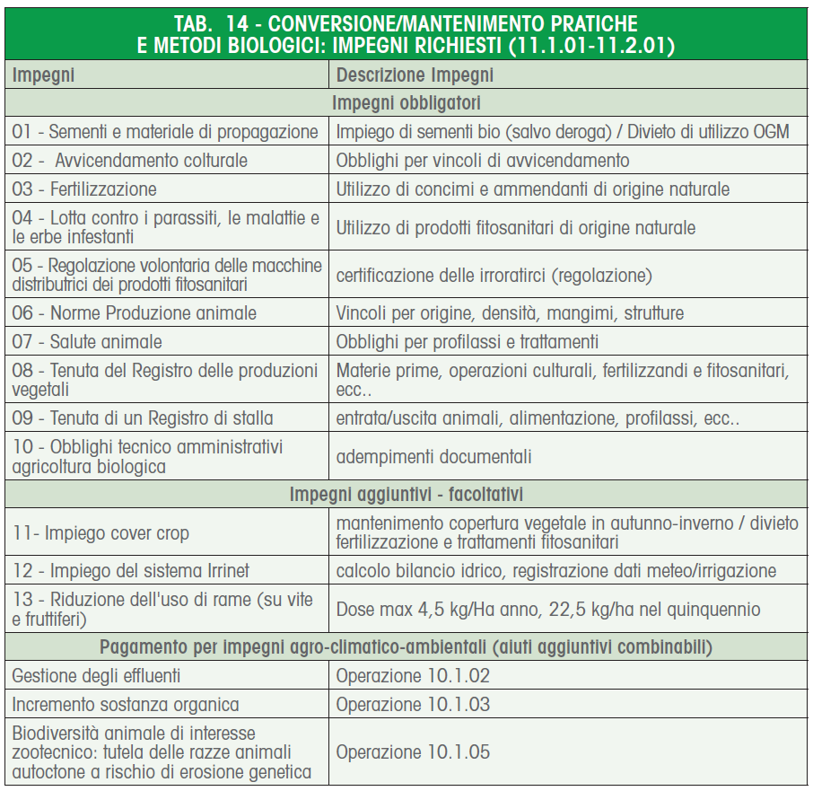
Produzione biologica – Misura 11
PSR 2014-2020
Gli IMPEGNI nel dettaglio
Direzione Generale Agricoltura, Caccia e Pesca

Slide 10
Produzione biologica – Misura 11
Aiuti per Agricoltura biologica (Misura 11)
Aiuti da 90 a 740 E/ha a seconda di introduzione e mantenimento e del tipo di coltura per applicazione Reg 834/07; possibilità di adozione di ulteriori impegni anch’essi compensati fino a 170 E/ha l’uno.
Il bando 2016 (sempre con inizio impegno 1/1/2016) ha avuto richieste per quasi 11 Meuro rispetto ai 7,2 Meuro di disponibilità. Sono stati interessati oltre 50.000 ha. Fase di selezione in corso.
Direzione Generale Agricoltura, Caccia e Pesca
Notes:
10
10
10
10

Slide 11
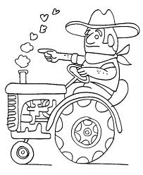
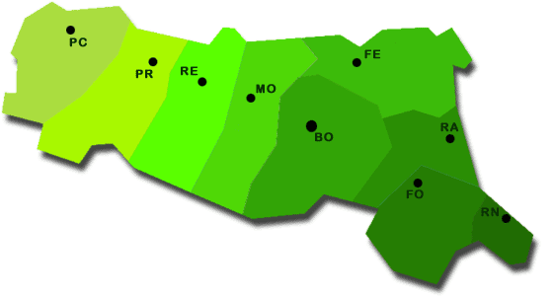
CBs controls and paying agency controls
Regional decree n. 1107/2011
12 CBs (operating in Emilia-Romagna)
In accordance to art. 27 of Reg. (CE) 834/2007, communicates the results of the controls carried out to the competent authority (Supervision Unit of Regional Administration).
Reg. CE 834 controls
informations
about
operator’s
infringment
Supervision on CBs
ORGANIC FARMER/
BENEFICIARY
Paying agency
In accordance to art. 33 of
Reg. (CE) 65/2011 Regional Administration + Paying Agency (AGREA) send informations to the Provinces in charge of investigations on the beneficiaries for the calculation of the reduction of the aid. At the same time the blocks are inserted into the computer program of liquidations.
informations about
beneficiary’s infringment
Local Administration: Province
receives the informations and calculates the reduction in aid

Slide 12
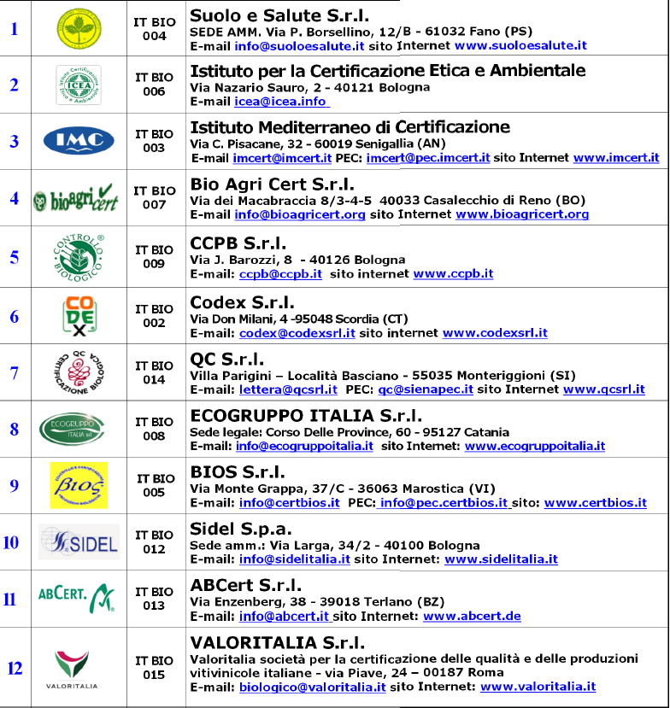
Control system in Italy – Delegated Control bodies
12 delegated control bodies, authorized by competent athority
ROLE AND RESPONSIBILITIES:
Control of operators compliance with European, national and regional laws by the application of the control plan approved by the competent authority
Maintenance of authorization requirements
Direzione Generale Agricoltura, Caccia e Pesca

Slide 13
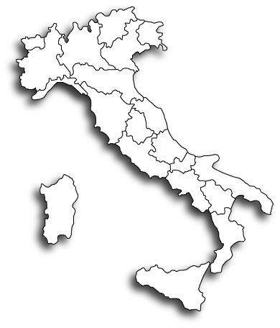
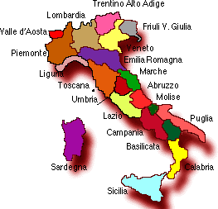
Supervision on CBs in Italy
Legislative Decree nr. 220/95 and Ministerial Decree 16 febbraio 2012
Ministero delle Politiche Agricole, alimentari e forestali
Ispettorato centrale della tutela della qualità e repressione frodi dei prodotti agroalimentari: ICQRF
FUNCTIONS:
- GRANT AND WITHDRAWAL AUTHORIZATION CBs (VICO)
- SUPERVISION on CBs (subsidiarity for the whole country) (PREF)
- ADMINISTRATIVE SANCTIONS on operators (for labelling and/or fraud)
Roma
in coordination with
(DM 16 febbraio 2012)
Department of Agricolture of the 19 Regions e 2 Provinces Auton.
FUNCTIONS:
- SUPERVISION on CBs in the territory under its jurisdiction

Slide 14
Sustainable agriculture: Organic and integrated production
«Integrated production approach»
The engagement of Emilia-Romagna region for sustainable agriculture and a better public health started 30 years ago with
the introduction in farming the «Integrated Production approach»
The main objetive:
Support farming rules and adoption of disciplineries of production
Specific objetives:
to reduce the use of pesticides with pest and weed control;
to optimize the use of fertilisers taking into account of type of soil, manure and treatment and disposal;
to support crop rotation, soil and irrigation management
Extention service and technical advise.
Direzione Generale Agricoltura, Caccia e Pesca

Slide 15
Sustainable agriculture: «Integrated production approach»
The Extention service and technical advise for the «Integrated Production approach» now include supports for:
Public OPEN DATA: data base and information for better farm management
Thematic maps (for typologis of soil)
Weather forecast
Irrigation/watering management
Technical bulletins (booklets)
Studies and researchs
A specific law and a public label
The integrated production interest more than
64,000 ha of vegetables and 55,000 Ha of fruits
«
Integrated productions | vegetables | fruits
Production obtained with integrated production (tons) | 2,490,872 | 2,610,912
Utilised Agricoltural Area of integrated production (ha) | 64,091 | 55,337
Direzione Generale Agricoltura, Caccia e Pesca

Slide 16
Sustainable agriculture: Food Chain Aproach
Food Chain Aproach (Filiéré)
Regione Emilia-Romagna facilitate networking agreements between economic operators of food chain with:
production planning,
fair terms of payment,
best practises
integrated farming or sustainable farming).
Examples of Food Chain Approach:
100% North Italy processed tomato under contract (all Integrated production and a little quantity Organic)
2/3 Emilia-Romagna potatoes under contract (all IP sustainable rules – similar to IP)
1/3 Emilia-Romagna durum wheat under contract (all sustainable rules similar to IP)
A significative part of Rural Development Programme for 2014-20202 are devoted to finance integrated food chain projects (Filiere aproach)
Direzione Generale Agricoltura, Caccia e Pesca

Slide 17
Sustainable agriculture: Producers Organization (PO)
Producer organizations (PO) and Interbranch Organization (IP)
The PO and IP active in milia Romagna in 2014 are more thane 40, with the main objectives to stimulate the agregation of fragmented supply and increase the market power of agricultural farmers
Vegetable and fruit sector:
27 Producers Organizations (POs) and 6 Association of PO
with a turnover of about 1,700 millions €
Other sectors (milk and cheese, beef and porck, cereals, potatoes, fodder, …)
21 Producers Organizations (POs) with 22,000 producers associated
with 900 millions € of turnover
4 Interbranch Organizations (IO) (processed tomato, porck, pear, eggs) working in several regions
17
Direzione Generale Agricoltura, Caccia e Pesca

Slide 18
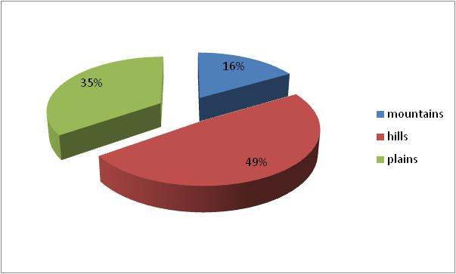
Sustainable agriculture: Agritourism
1,100 agri-tourisms active in 2014 in Emilia-Romagna
(+2.7% over 2013)
4.5 mln meals served per year.
9,200 beds
65% of agr-iturism enterprices are located in Mountain and Hill areas
Agri-tourism for altitudinal areas
More than 300 educational farms (didatic farms) are active in ER .
18
Direzione Generale Agricoltura, Caccia e Pesca

Slide 19
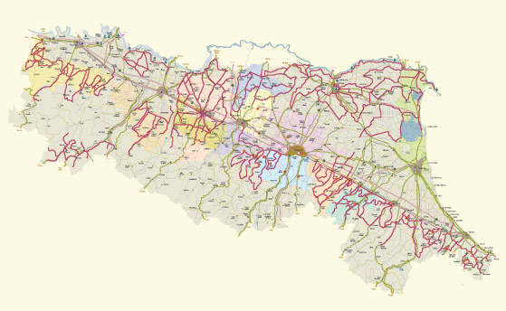
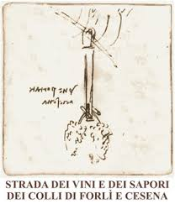
Sustainable agriculture: Wine and food roads
15 Food and Wine roads have been created in all the provinces
The itineraries join restaurants, wineries, agri-tourism, guest-houses, farms, cheese factories, crafts and arts workshops.
In 2012 the Protected areas in Emilia-Romagna
where more than 93,300 hectares, of which:
30,700 Ha of National Parks and 52,000 ha of Regional Natural Parks.
19
Direzione Generale Agricoltura, Caccia e Pesca

Slide 20
Thank you.
Regione Emilia-Romagna
Links
Rapporto 2015«The agrifood system in Emilia-Romagna» e-Book:
http://agricoltura.regione.emilia-romagna.it/entra-in-regione/statistica-e-osservatorio/sistema-agro-alimentare/rapporto-2015/rapporto-2015
The program of Rural Development for 2014- 2020
http://agricoltura.regione.emilia-romagna.it/psr-2014-2020
Direzione Generale Agricoltura, Caccia e Pesca

